Slide 1
Negotiated Workplace Learning
Week 3
Sandra Okwara

Slide 2

Evaluation of Workplace Issues

Slide 3

Well designed and working effectively ? Identification of gaps in an organisation is an important step in changing things in the organisation

Slide 4

Are there gaps in your Organisation?
Assessment of the organisation
Assessment of the team
Identify room for potential Improvement
What opportunities are available?
This Photo by Unknown Author is licensed under CC BY-SA-NC

Slide 5
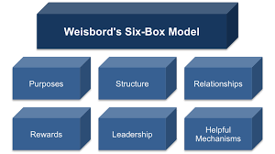
Weisbord’s Six Box model

Slide 6
Using the Six-Box Model as a Strategic Tool
Simple and straight forward
Helps to create consistency with the organisation mission, environment, and internal processes, to improve chances of success
Emphasizes the need for internal consistency
Acknowledges the role of the external environment

Slide 7
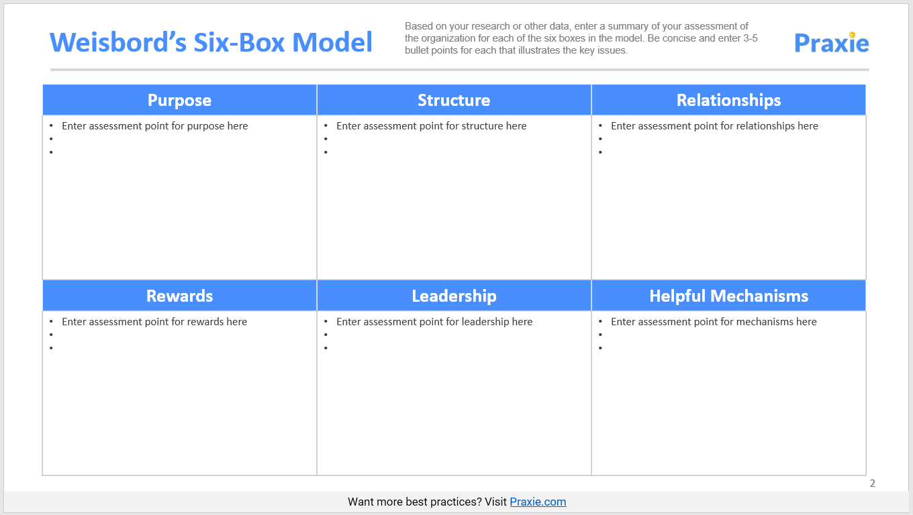
Using the wisebord six box model

Slide 8

Purposes of the organisation
Mission and Vision of the organisation
Does the organisation have a clear mission and vision?
How are the goals of the organisation established using the mission and vision
Do the members of the organisation understand the goals and agree with them?
Do the employees take part in setting the goals?
Do the goals take consideration of the competencies and capabilities of the employees?
Does the organisation do what they say in their mission and vision statement?

Slide 9

STRUCTURE OF THE ORGANISATION
Is the organisation design fit for purpose?
Does the organisation structure support effective communication
Are there formal and informal structures in the organisation? The differences need to be identified.
Is there accountability in the formal and informal Structurers?
This Photo by Unknown Author is licensed under CC BY-SA

Slide 10

Importance of team development process
Staff relate and communicate well ?
Department and units communicating well with each other?
Do staff match with their job roles?

Slide 11
What is the level of interdependence?
Are there conflicts in the organisation?
How is conflict Resolution done?
What happens after conflicts are resolved?

Slide 12

Strategies on providing effective and motivating rewards
Do formal rewards reflect the accomplishment of the organisation ?
Do the rewards work effectively?
Who gets Rewarded and for what?
Are rewards timely and equitable
Are the rewards in line with the organizational vision and goals

Slide 13

Leadership
Leaders understand the mission and vision
Is the purpose still valid ?
Do leaders reflect the purpose?
How are the leaders chosen
Are the leaders effective and provide right direction?
This Photo by Unknown Author is licensed under CC BY

Slide 14
Available Support Mechanism
Are there planning, budgeting, and controlling systems in place ?
Are there supportive policies and procedures?
Is there supportive, efficient and effective communication?
How is performance measurement evaluated?
Is training and development used to align the expectation of effective performance?

Slide 15
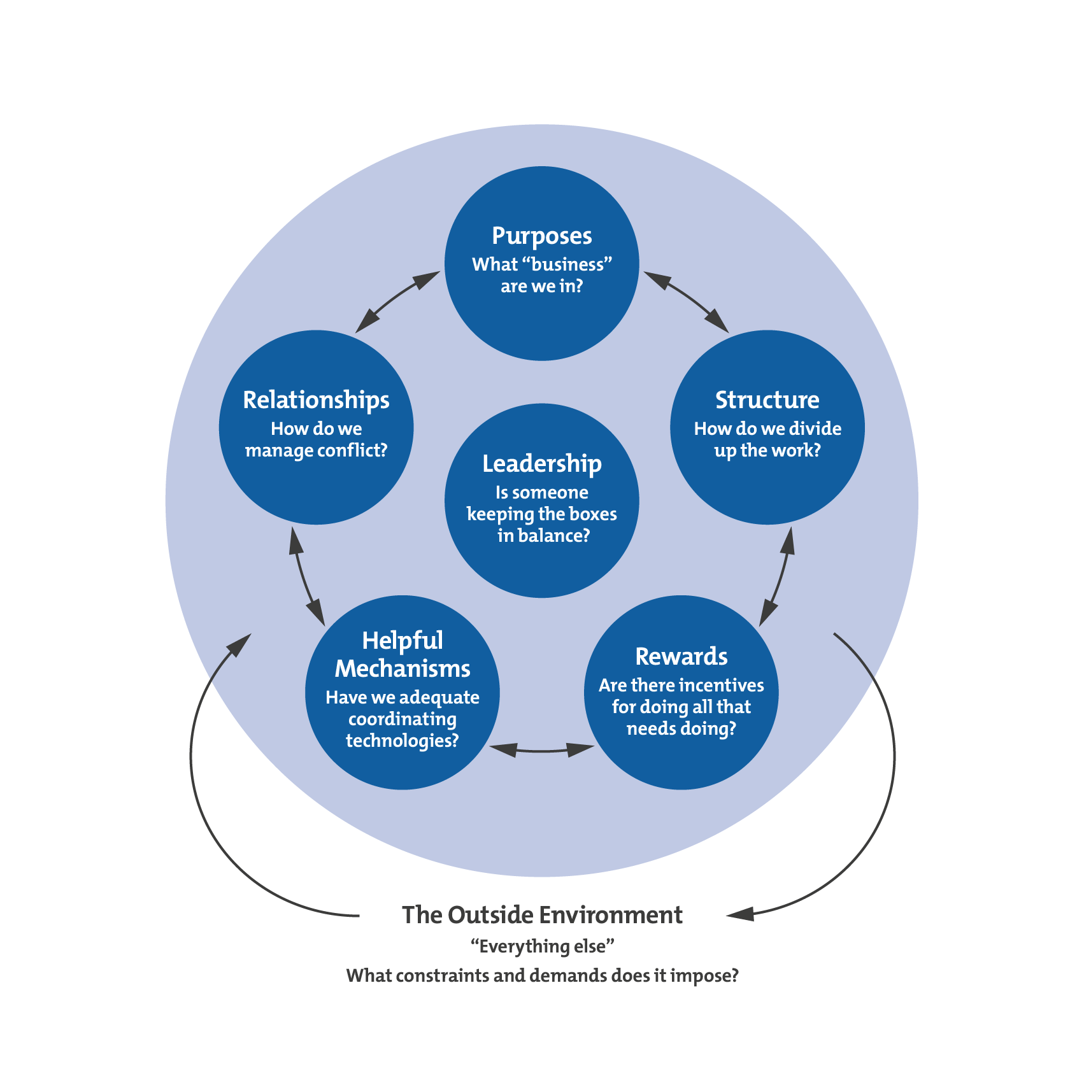
Connection of the elements with each other

Slide 16
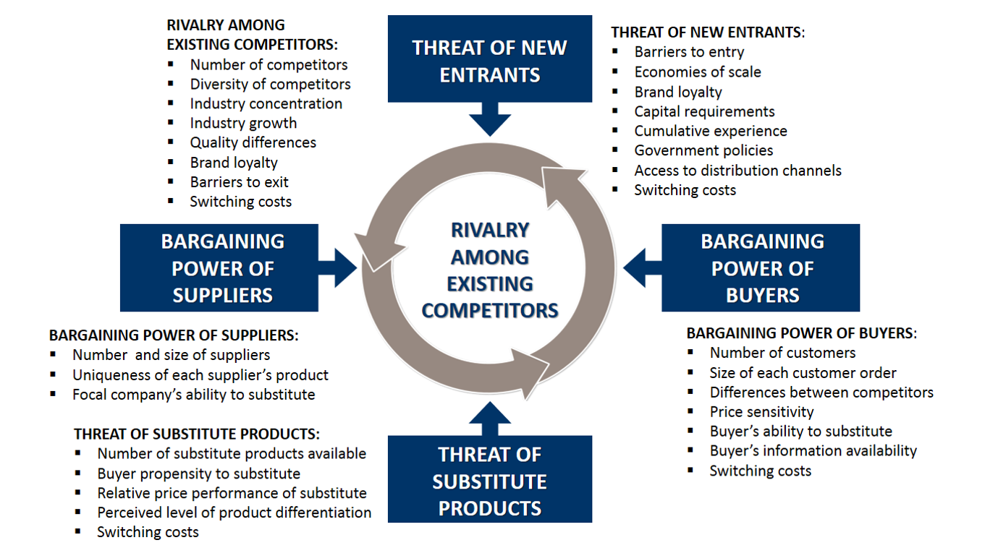
External Environment

Slide 17
External Environment

Slide 18
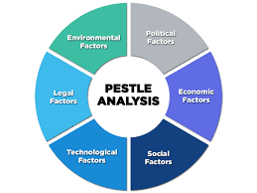
External Environment

Slide 19
Weisbord's Model Compared with Other Strategic Tools
All of these models emerged in the late 1970s and early 1980s
While they take different approaches, the message is the same:
Create consistency with your mission, environment and internal processes, You will improve your chances of success.
Weisbord | McKinsey 7S | Miles and Snow | Nadler and Tushman
Purpose | Strategy Shared Values | Strategy | Strategy
Structure | Structure Skills | Structure | Structure Work
Relationships | Staff |  | People
Rewards
Leadership | Style |  | Culture
Supporting Mechanisms | Systems |  | Culture
Outside Environment |  | Environment

Slide 20
REFERENCES
Weisbord, M. (1979) 'Organizational Diagnosis: Six Places to Look for Trouble With or Without a Theory,' Group and Organizational Studies, Volume 1, No. 4. (Available here.) [Accessed 16 July 2013.

